Slide 1

ADVANCED LANE FINDING
EL-302 Digital Image Processing
Akshat Joshi (BT20HCS083)
Vaibhav Mishra (BT20HCS202)
Gaytri Sran (BT20HCS190)
Atharv Tushar Deogaonkar (BT20HCS098)

Slide 2
MOTIVATION
Increasing number of cars on road
Developing road infrastructure promoting more use of road transport over other modes of transport
To reduce number of car accidents happening due to lane departure
Autonomous Driving or Advanced Cruise Control

Slide 3
INTRODUCTION
To detect Lane Boundary for straight and curved lanes
Implement LDP in a way to position the vehicle in the centre of it’s lane by:
Audible Warning or
Vibrations on the Steering Wheel or
Flashing a Warning Light or all
To Overcome the Challenges such as bad weather and low visibility

Slide 4
ALGORITHM
Given a set of chessboard images, compute the camera calibration matrix and distortion coefficients.
Apply a distortion correction to raw images.
Apply a perspective transform to rectify binary image.
Use color transforms, gradients, etc., to create a thresholded binary image.
Detect lane pixels and fit to find the lane boundary.
Determine the curvature of the lane and vehicle position with respect to center.
Warp the detected lane boundaries back onto the original image.
Output visual display of the lane boundaries and numerical estimation of lane curvature and vehicle position.

Slide 5
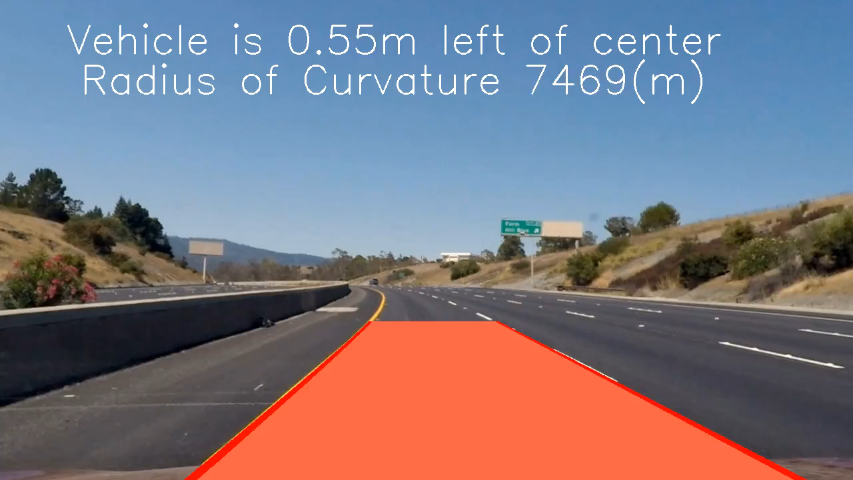
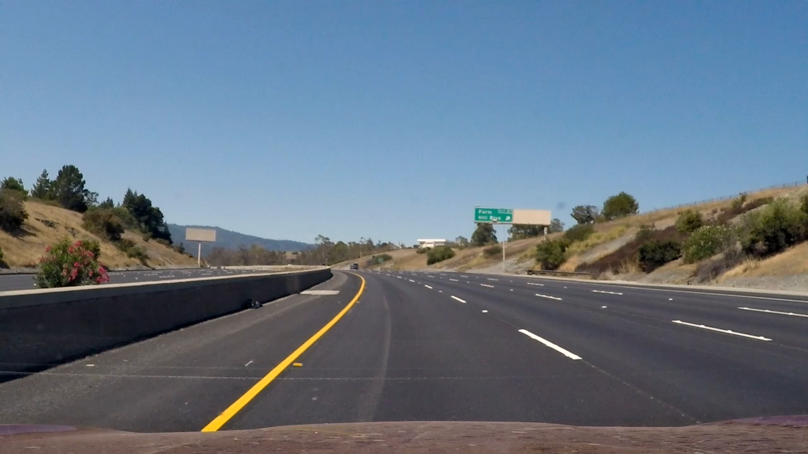
IMPLEMENTATION
Input Video –
Code -
Output Video -

Slide 6
THANK YOU !!

